Slide 1

Identifying SBA lending opportunities for Santander Bank
University of Massachusetts Lowell
Master of Science in Business Analytics
Capstone Project, Fall 2021
By: Sam Depari, Richard Bedard, Koushik Reddy
Faculty Advisors: Belleh Fontem, Luvai Motiwalla
Project Sponsors: Nadia Naeem, Linkan Ray
Notes:
*Be sure to thank Professors Fontem, Motiwalla, and sponsors*

Slide 2


Project Background & Goals
The Small Business Administration (SBA) helps Americans start, build, and grow businesses
SBA sets guidelines for lenders, reduces the risk of lending through subsidization, and improves access to funds for small businesses
Santander acts as a loan servicer in conjunction with the SBA, and in competition with other banks
Objectives of the project:
To identify lending opportunities through descriptive statistics/visualizations, identify where Santander sets itself apart from their competitors and identify insights where there is potential to set itself apart further
Building a predictive model to predict the loan amount a business gets approved
Notes:
*Santander to present*
I think we need a couple of points here to explain about the santander

Slide 3
Project Methodology
Business Understanding:
Identify the lending opportunities from the SBA data analysis
Data Understanding:
Last 50 years of SBA approved loan data is available to analyze
Data Preparation:
Last 5 years of data is cleaned and made it suitable for the model to identify the trends
Modeling:
In order to forecast the loan amount business could be eligible for, regression techniques would be suitable
Evaluation:
Sincere our predictor variable falls into categorical type, ordinal regression technique is chosen.
Deployment:
The model has provided key insights which on analysis has proven to be vital for identifying the opportunities available for lending

Slide 4

Data Preparation
The last 50 years of SBA approved loan data is available but in order to capture the current trends only last 5 years of data is used for analysis
Data is cleaned and reformatted via:
renaming the columns
changing the data types
dropping the outliers
filling the missing values based on a mean/median/mode value
eliminated variables having more than 80% of missing values
Categorized the business into supersector category based on the North American Industry classification (NAICS) code provided
Transformed various kinds of loan delivery methods into four major categories called SBA express, PLP, OTH 7A and the remaining loans into others category
For descriptive analysis, the data was filtered into the regional footprint where Santander has a presence. The regions included are CT, MA, ME, NH, RI, VT, PA, NY, NJ, DE

Slide 5
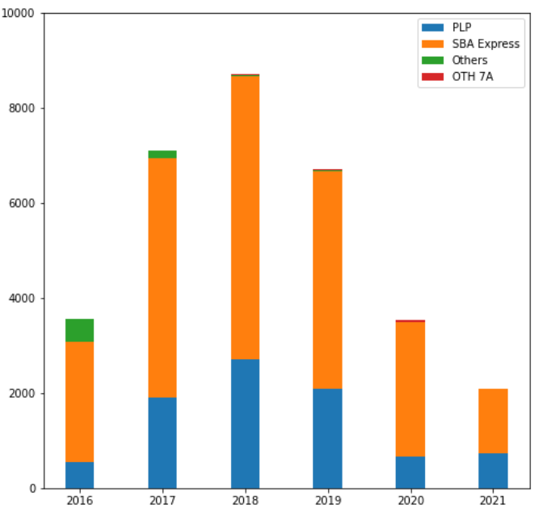
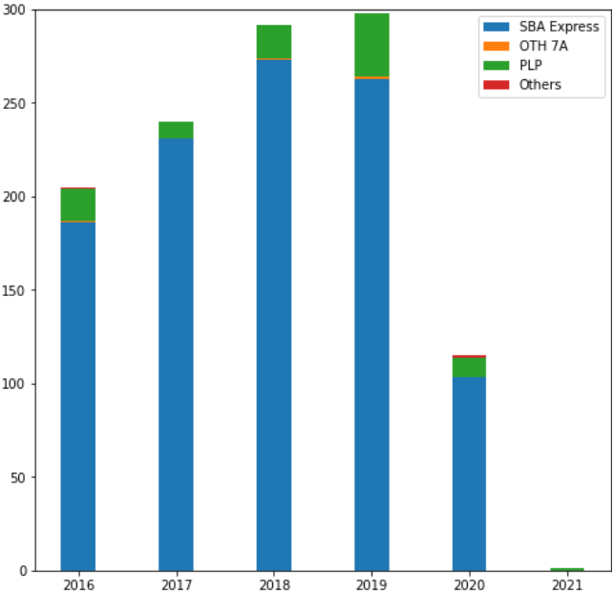
Descriptive Analytics
Competitors’ count of loan approvals for the last 5 years
Santander’s count of loan approvals for the last 5 years
Notes:
Both the Santander and its competitors are having their highest loans sanctioned for SBA express
Its competitors are having high approvals for PLP loans compared to Santander
Banks tend to specialize by delivery method, but distribution by supersector was fairly standard
Santander was hit harder than competitors in terms of post 2019 loan servicing, potentially pandemic related

Slide 6
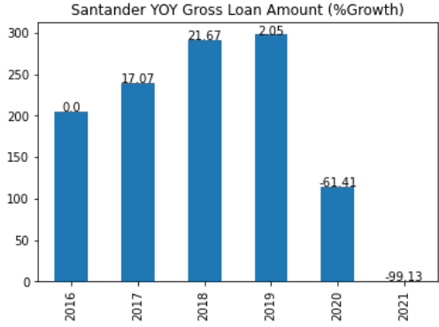
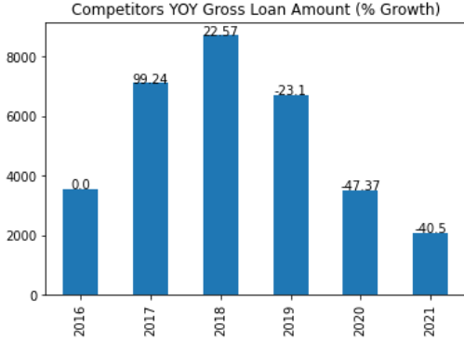
Descriptive Analytics
Notes:
The graphs depict that over the years there has been a decline in the Gross approval amount both for the Santander and its competitors but Santander has been hit hard by almost losing 60% of its business compared to competitors 47% in the year 2020

Slide 7
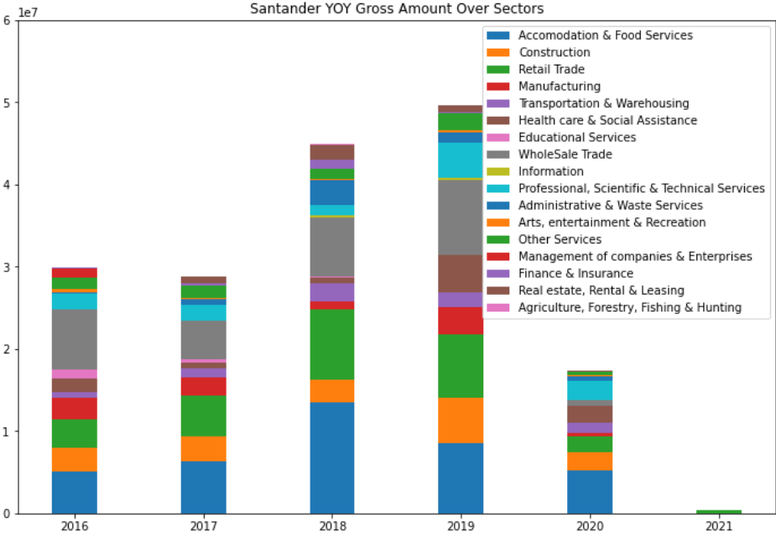
Descriptive Analytics
Santander YOY Gross Amount Approval
Notes:
Over the last 5 years in terms of sector approval Santander is having its presence only in limited sectors like Accomodation and food, Wholesale trade and last two years the bank is losing the presence in construction sector

Slide 8
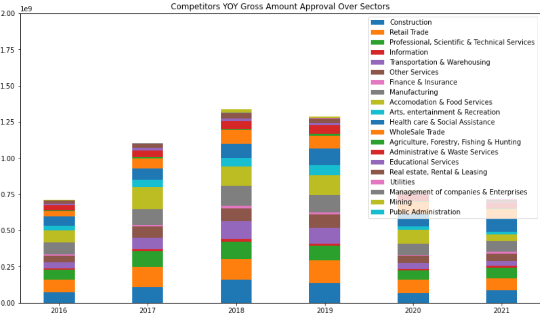
Descriptive Analytics
Competitors YOY Gross Amount Approval
Notes:
The competitors are having their presence in wide range of industry sectors like Transportation and warehousing, Finance, Retail trade which on exploitation can prove to be significant in improving the lending opportunities for the bank

Slide 9


Predictive Analytics
Based on the gross approval loan range, the dataset is divided into four buckets from Low [0-300000], Moderate (300000 - 1000000], High (1000000 - 2000000], Huge (2000000 - 5000000]
Based on our target variable, the model we chose is the ordinal regression model and the tool used for performing the model is the IBM SPSS
The biggest constraint for the model is that the independent variables should be either continuous or categorical
In order to analyze the income importance on loan approval, Median Income based on state county is mapped to each business public data
The variables used for analysis are DeliveryMethod, InitialInterestRate, JobsSupported, Supersector, Median Income, SBAGuaranteed%

Slide 10

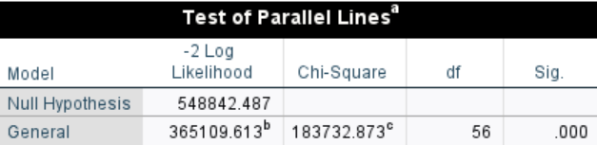

Prediction Model Insights
The model result concludes that the independent variables fit into the model are significant and we can reject null hypothesis
Jobs Supported and Median income are having negative correlation
Businesses approved for PLP loan kind have a higher chance of getting huge amounts
Certain Industries are being sanctioned higher loan amounts like Management, Public Administration, Finance, Information
Agriculture and Forestry Industry has a negative correlations on the loan amount

Slide 11
Limitations and Lessons Learned
Limitations:
Inconsistent/missing data from a large amount of records, especially 2021
Only the businesses whose loans are approved is provided in the data
The 2020 data acted as an outlier in terms of loan approval due covid and was unable to explain by the model.
Lessons Learned:
Rather than attempting to predict an exact integer, predicting the estimated approval size proved to yield a more accurate and useful model
While Santander’s internal data would be very useful in explaining the charge off rates and for further analysis, the publicly disclosed data yielded an analysis that was very insightful
Focusing on a few goals that aligned with the banks interest was much easier than trying to solve every problem at once

Slide 12
Thank you for your time! Any Questions?

